Slide 1
Databases and Database Users
Lecture 1
Dr. Marwa Hussien

Slide 2

About the Course
Text book: Fundamentals of Database Systems.
Course has 100 points:
50 points (final)
15 points (mid-term exam)
15 points (lab work)
20 points (lab exam)

Slide 3

Outline
Basic Definitions
Types of Databases and Database Applications
Typical DBMS Functionality
Example of a Database (UNIVERSITY)
Main Characteristics of the Database Approach
Types of Database Users
Advantages of Using the Database Approach
Centralized and Client-Server Architectures

Slide 4
Basic Definitions
Database: a collection of related data.
Data: is a collection of facts and figures that can be processed to produce information.
Database Management System (DBMS): a software package/ system to facilitate the creation and maintenance of a computerized database. It stores data in such a way that it becomes easier to retrieve, manipulate, and produce information.
Database System: the DBMS software together with the data itself. Sometimes, the applications are also included.

Slide 5
Database Implicit Properties
A database represents some aspect of the real world, sometimes called the miniworld or the universe of discourse (UoD).
A database is a logically coherent collection of data with some inherent meaning.
A random assortment of data cannot correctly be referred to as a database.
A database is designed, built, and populated with data for a specific purpose. It has an intended group of users and some preconceived applications in which these users are interested.

Slide 6
Types of Databases and Database Applications
Traditional Applications:
Numeric and Textual Databases
More Recent Applications:
Multimedia Databases
Geographic Information Systems (GIS)
Biological and Genome Databases
Data Warehouses
Mobile databases
Real-time and Active Databases

Slide 7
Impact of Databases and Database Technology
Businesses: Banking, Insurance, Retail, Transportation, Healthcare, Manufacturing
Service Industries: Financial, Real-estate, Legal, Electronic Commerce, Small businesses
Education : Resources for content and Delivery
More recently: Social Networks, Environmental and Scientific Applications, Medicine and Genetics
Personalized Applications: based on smart mobile devices

Slide 8
Recent Types of Database Developments
Social Networks started capturing a lot of information about people and about communications among people-posts, tweets, photos, videos in systems such as:
Facebook - Twitter - Linked-In: all constitutes data)
Search Engines
Google, Bing, Yahoo : collect their own repository of web pages for searching purposes
Big Data storage systems involving large clusters of distributed computers
NOSQL (Not Only SQL) systems
A large amount of data now resides on the “cloud” which means it is in huge data centers using thousands of machines.

Slide 9
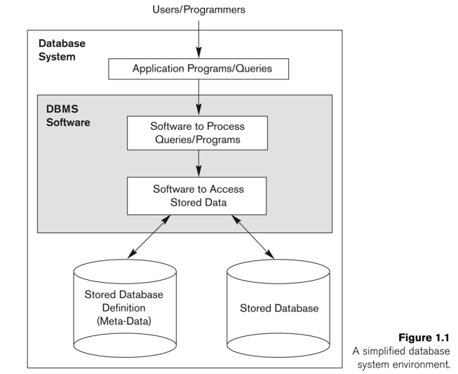

Simplified Database System Environment

Slide 10
Typical DBMS Functionality
Define a particular database in terms of its data types, structures, and constraints
Construct or Load the initial database contents on a secondary storage medium
Manipulating the database:
Retrieval: Querying, generating reports
Modification: Insertions, deletions and updates to its content
Accessing the database through Web applications
Processing and Sharing by a set of concurrent users and application programs – yet, keeping all data valid and consistent

Slide 11
Typical DBMS Functionality
Security measures to prevent unauthorized access
“Active” processing to take internal actions on data
Presentation and Visualization of data
Maintenance of the database and associated programs over the lifetime of the database application
Database Protection includes system protection against hardware or software malfunction (or crashes) and security protection against unauthorized or malicious access.

Slide 12
Application Activities Against a Database
Applications interact with a database by generating:
Queries: that access different parts of data and formulate the result of a request
Transactions: that may read some data and “update” certain values or generate new data and store that in the database
Applications must not allow unauthorized users to access data
Applications must keep up with changing user requirements against the database

